Slide 1
Final Report
Capstone Project – Meatballs, Pizza, & Pasta in NYC

Slide 2
Introduction:
New York City(NYC) is one of the largest and ethnically diverse cities in the world. It is the largest city in the United States and for a long period of time, served as an entrance point into the US for many immigrants around the globe. NYC is home to over 8 million people and the city alone houses more people than 37 states. The entire NYC metro area is home to over 23.5 million individuals and is over 5000 sq/mi. It is by far the larges metro area in the US. NYC continues to serve as a melting pot and home for diversity and culture. With this expansive diversity comes a plethora of food options. Whether it be sushi, pizza, burgers, gyros, or curry, you truly can find anything your stomach is craving in the city that never sleeps.

Slide 3
Problem:
Below are the questions we would like to address:
Which neighbourhoods in NYC have highly rated Italian restaurants?
Which neighbourhood in NYC is the best for Italian food, ratings, and quantity?
Which borough in NYC lacks quality Italian restaurants?
Which neighbourhoods in NYC are the best place to stay if you prefer Italian cuisine?

Slide 4
Data Section:
For this project we need the following data:
• New York City data containing a list of Boroughs, Neighbourhoods and their corresponding coordinates
o Source: https://cocl.us/new_york_dataset
o Description: This data set contains the information needed.
• Italian restaurants in each neighbourhood of New York City
o Source: Foursquare API
o Description: This will allow us to get all venues and details about them for each neighbourhood.
• GeoSpace data
o Source: https://data.cityofnewyork.us/City-Government/Borough-Boundaries/tqmj-j8zm
o Description: This will give us the New York Borough Boundaries.

Slide 5
Methodology:
We began by collecting the NYC venue and NYC city data from the following links:
https://api.foursquare.com/v2/venues/{}?&client_id={}&client_secret={}&v={}
https://cocl.us/new_york_dataset

Slide 6
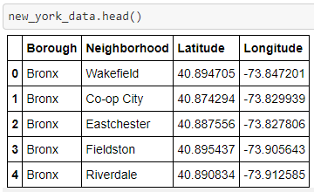
We then identified NYC neighbourhoods and locations using the API data:

Slide 7
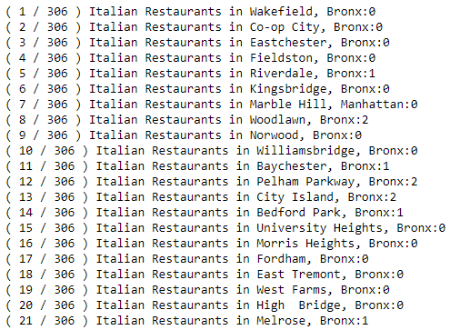
We then filtered out all Italian restaurants in each neighbourhood:

Slide 8
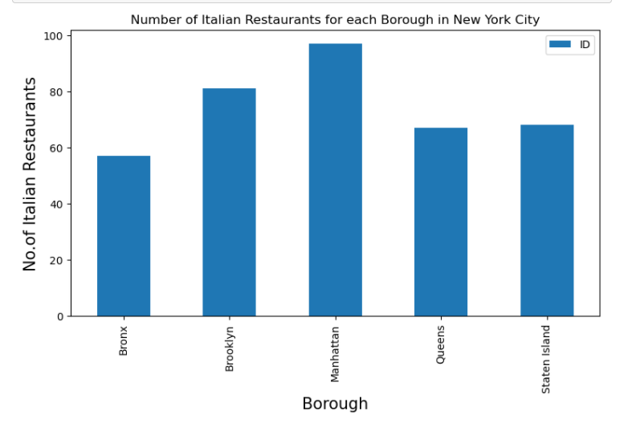
We then plotted the number of Italian restaurants per borough:

Slide 9
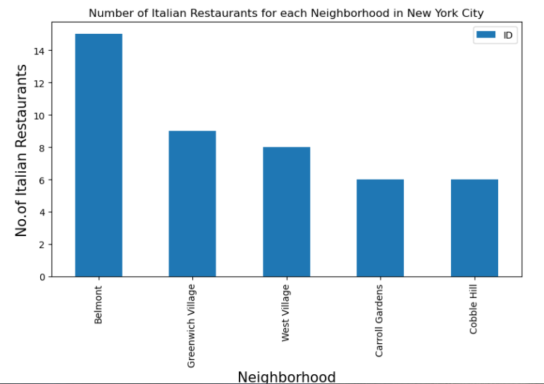
Next we plotted neighbourhoods with the most Italian restaurant venues:

Slide 10
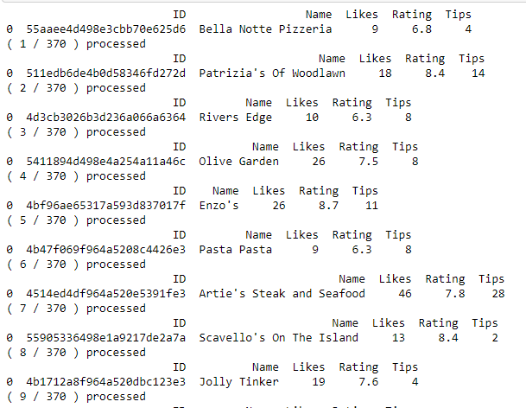
We then used Foursquare API to collect additional venue data including rating and likes:

Slide 11
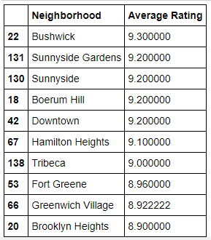
We then created a table of highest average rating by neighbourhood:

Slide 12
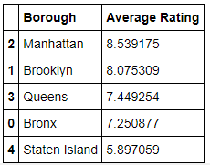
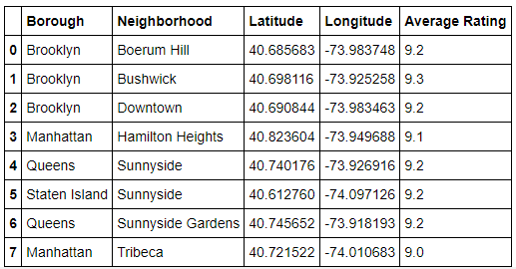
We created a chart to show which borough in NYC has the worst Italian restaurants:
Lastly we charted latitude and longitude along with average rating to understand where the best neighbourhoods were located:

Slide 13
Results:
Using the information above we will answer our questions:
Which neighbourhoods in NYC have the most Italian restaurants?
Belmont, Greenwich Village, West Village, Carrol Gardens, Cobble Hill
Which neighbourhood in NYC is the best for Italian food for ratings?
Bushwick, Sunnyside Gardens, Sunnyside, Boreum Hill, and Downtown
Which borough in NYC lacks quality Italian restaurants?
Staten Island
Which neighbourhoods in NYC are the best place to stay if you prefer Italian cuisine?
Belmont and Bushwick

Slide 14
Conclusion:
Overall, there are many Italian restaurants in NYC, however individual tastes and preferences will always trump the average consumers reviews. For this reason, it is best to experiment yourself and only use our findings as advice on how and where to find the best restaurants for you. We could potentially improve this report by including tips and reviews from other websites.

